Slide 1
08 | What’s Next and Resources
Jon Galloway | Tech Evangelist
Christopher Harrison | Head Geek

Slide 2
Module Overview
ASP.NET SignalR
Visual Studio 2013 and MVC 5 Sneak Preview
ASP.NET Resources

Slide 3
Introducing SignalR
Abstraction over transports
Events instead of task/async
Connection management
Broadcast or target specific client

Slide 4
What does SignalR do?
Client to Server persistent connection over HTTP
Easily build multi-user, real-time web applications
Auto-negotiates transport

Slide 5
SignalR Fallback
Long Polling
Forever Frames
Server Sent Events
Web Sockets

Slide 6
What does SignalR do?
Allows server-to-client push and RPC
Built async to scale to 1000’s of connections
Scale out with Service Bus, SQL Server & Redis
Open Source on GitHub

Slide 7
Client
Browser
Web
Server
HTTP GET – Got data?
HTTP GET – Got data?
HTTP GET – Got data?
HTTP GET – Got data?
HTTP GET – Got data?
HTTP GET – Got data?
HTTP GET – Got data?
HTTP GET – Got data?
HTTP GET – Got data?
HTTP GET – Got data?
HTTP GET – Got data?
HTTP GET – Got data?

Slide 8
Client
Browser
Web
Server
HTTP GET – You do realtime?
Sure, I’m a new server. I love realtime.
Let’s go!
Awesome

Slide 9
SignarlR Hub - Server
public class ChatHub : Hub
{
public void SendMessage(String message)
{
Clients.addMessage(message);
}
}

Slide 10
Chat with SignalR Hubs
var hub = $.connection.chat;
hub.addMessage = function (message) {
$("#msgs").append("<li>" + message + "</li>");
};
$.connection.hub.start().done(function () {
$("#send").click(function () {
hub.sendMessage($("#msg").val());
});
});

Slide 11
Using ASP.NET SignalR

Slide 12
Visual Studio Updates

Slide 13
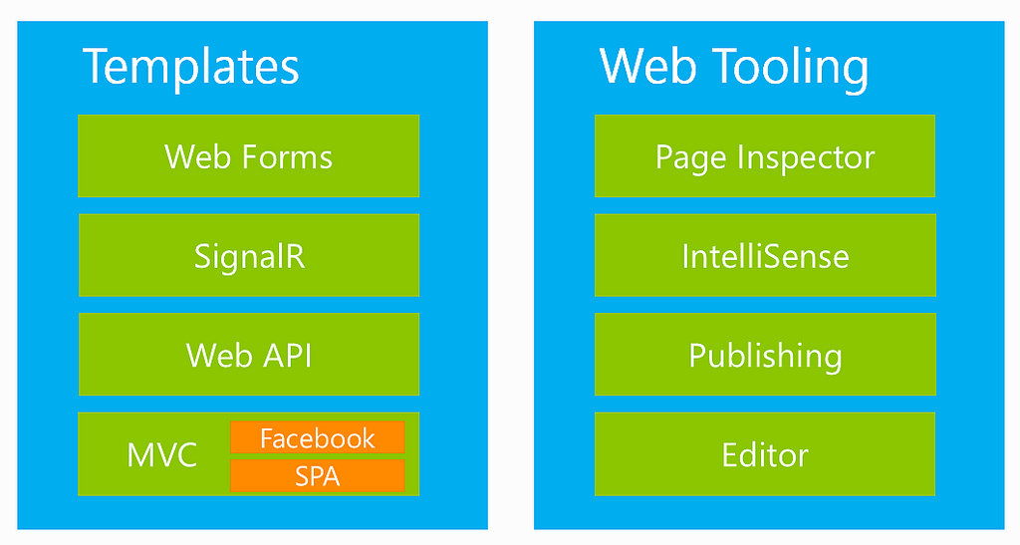
ASP.NET and Web Tools 2012.2 (Included in Visual Studio Updates)

Slide 14
Visual Studio 2013 RC
One ASP.NET
Browser Link
New HTML editor
Azure website tooling
Scaffolding
Owin
ASP.NET Identity
Download and more info at: http://www.asp.net/vnext

Slide 15
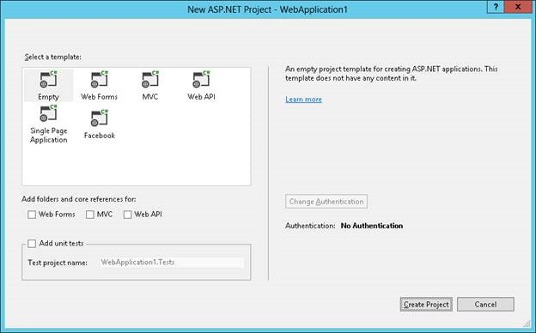
Visual Studio 2013 RC
One ASP.NET
Browser Link
New HTML editor
Azure website tooling
Scaffolding
Owin
ASP.NET Identity
Download and more info at: http://www.asp.net/vnext

Slide 16
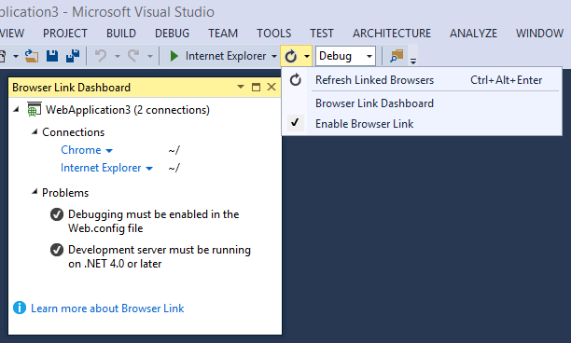
Visual Studio 2013 RC
One ASP.NET
Browser Link
New HTML editor
Azure website tooling
Scaffolding
Owin
ASP.NET Identity
Download and more info at: http://www.asp.net/vnext

Slide 17
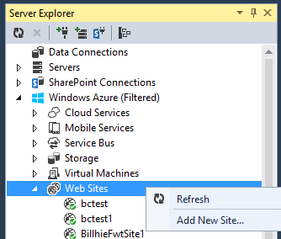
Visual Studio 2013 RC
One ASP.NET
Browser Link
New HTML editor
Azure website tooling
Scaffolding
Owin
ASP.NET Identity
Download and more info at: http://www.asp.net/vnext

Slide 18
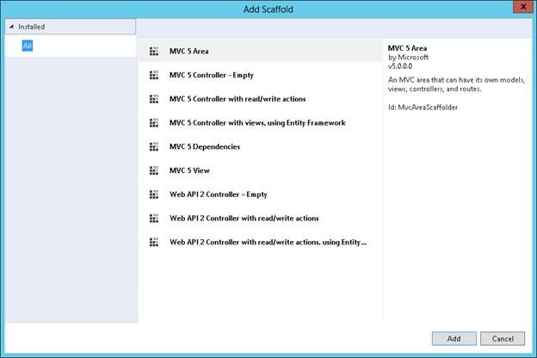
Visual Studio 2013 RC
One ASP.NET
Browser Link
New HTML editor
Azure website tooling
Scaffolding
Owin
ASP.NET Identity
Download and more info at: http://www.asp.net/vnext

Slide 19
Visual Studio 2013 and MVC 5

Slide 20
Resources

Slide 21
ASP.NET Questions
http://www.asp.net/feedback
Twitter - @aspnet
Facebook - /ASPNET
G+ - ASP.NET

Slide 22
Web Camps
http://www.devcamps.ms
http://aka.ms/webcamps-training-kit

Slide 23
Windows Azure
http://www.windowsazure.com

Slide 24
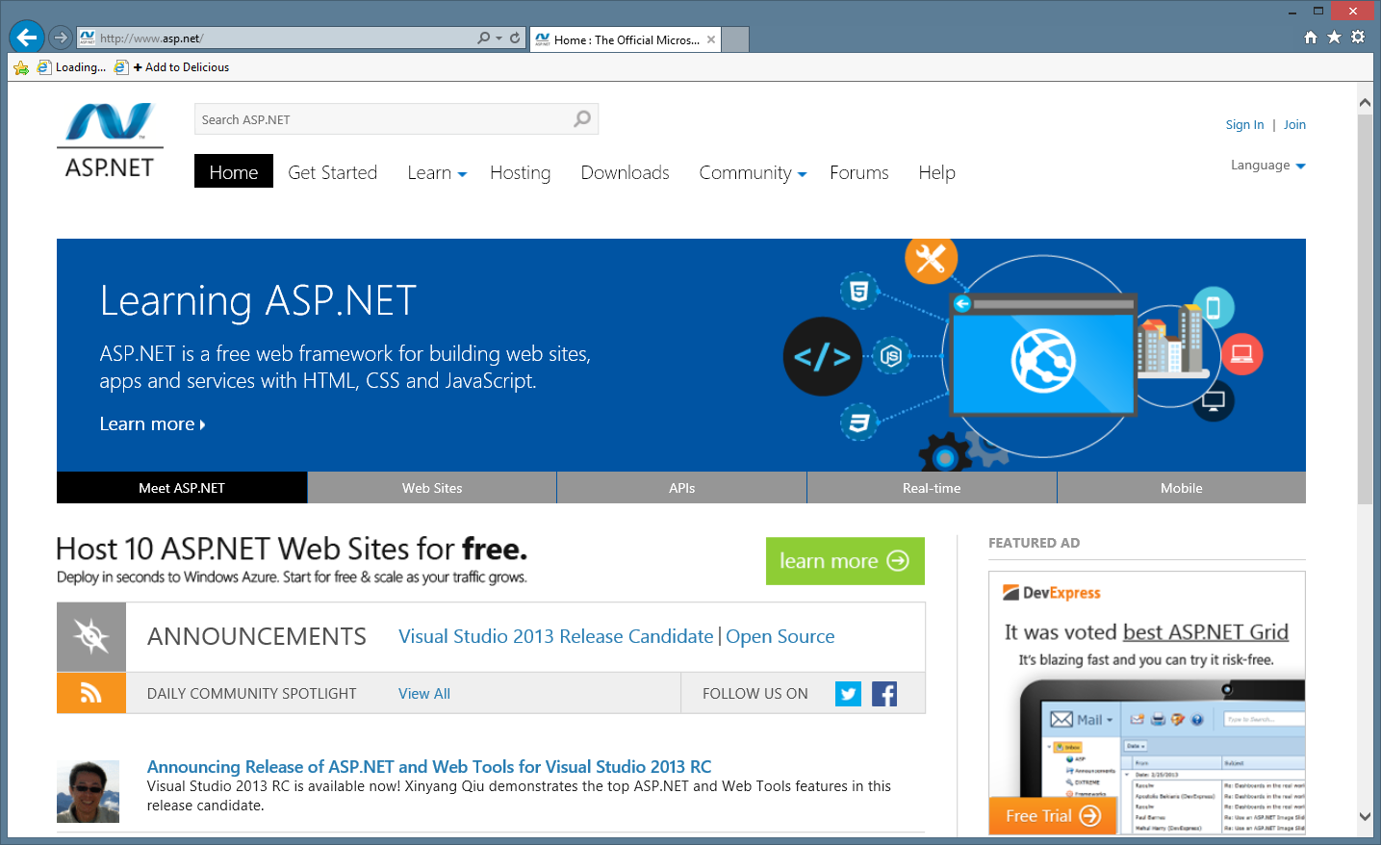
ASP.NET site

